Slide 1


Slide 2
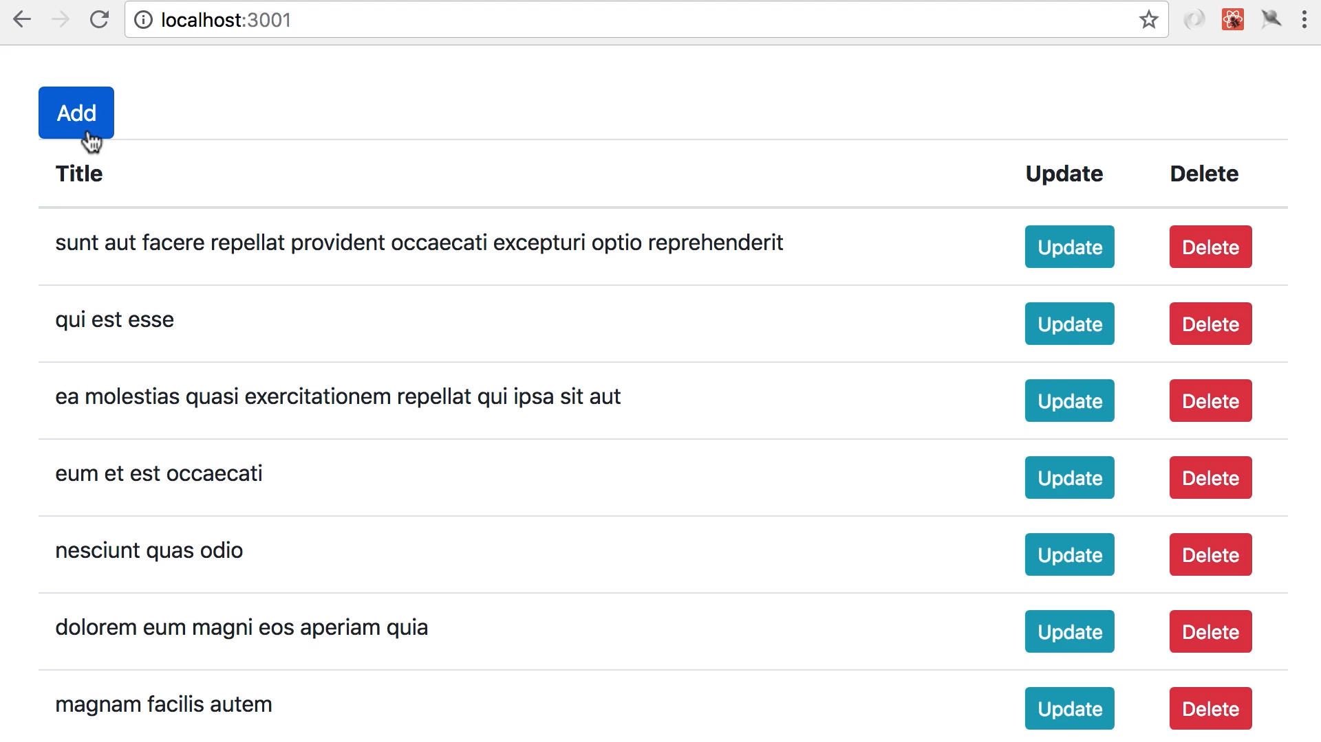

Slide 3
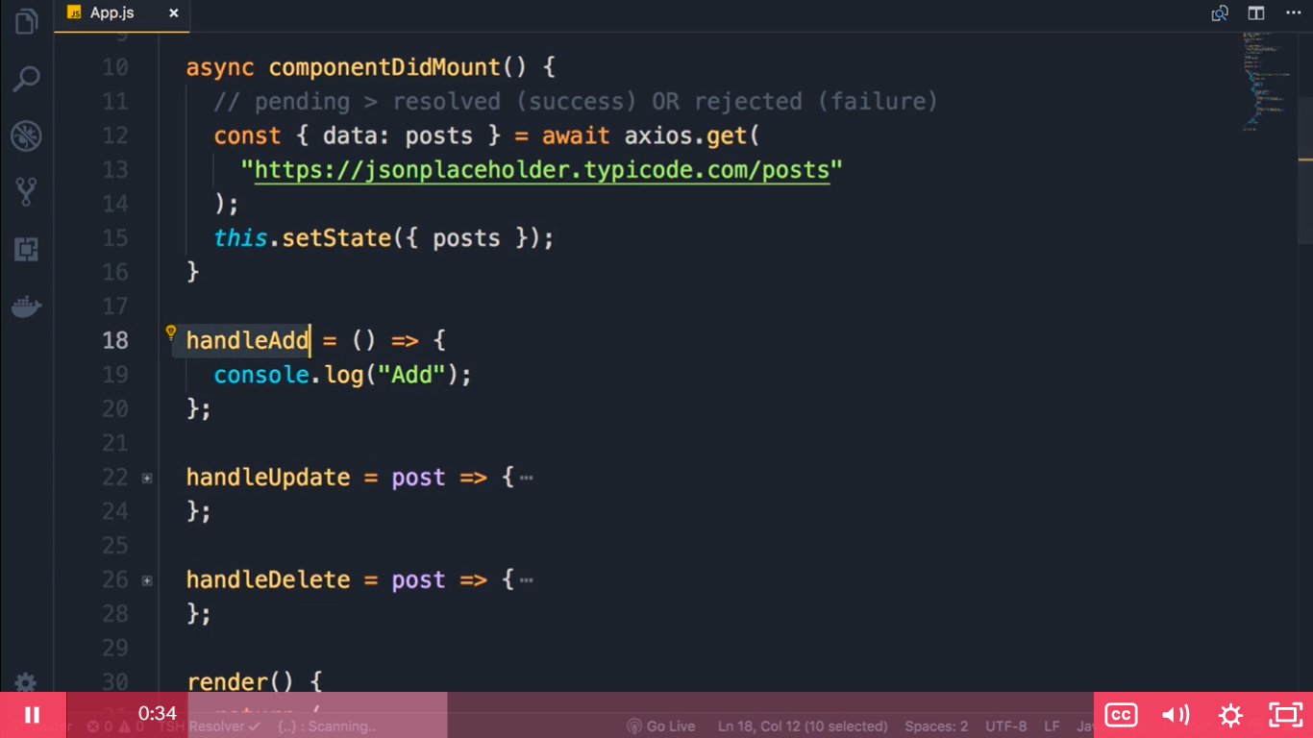

Slide 4
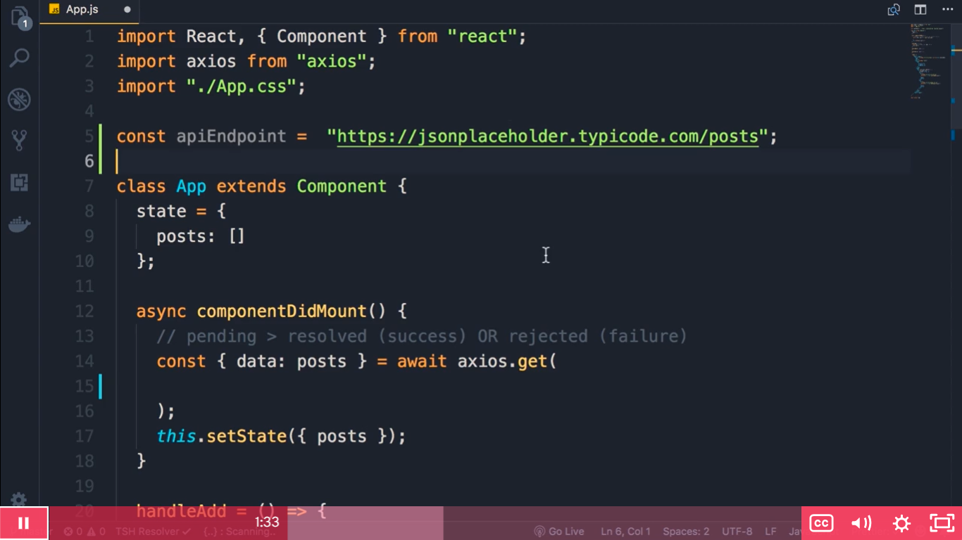
Instead of repeating the endpoint again and again we will create it as an const and reuse it line number 5

Slide 5
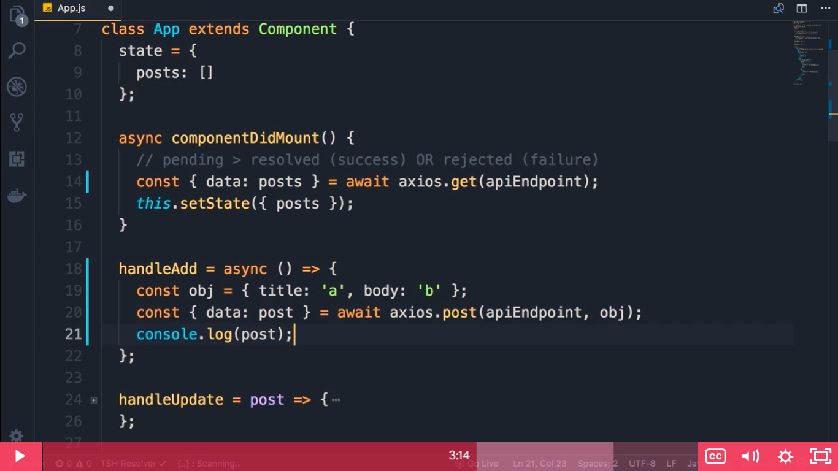
componentDidMount is a method so async is added before handleAdd is a property so async is added before the arrow function. Also do changes to line 14

Slide 6
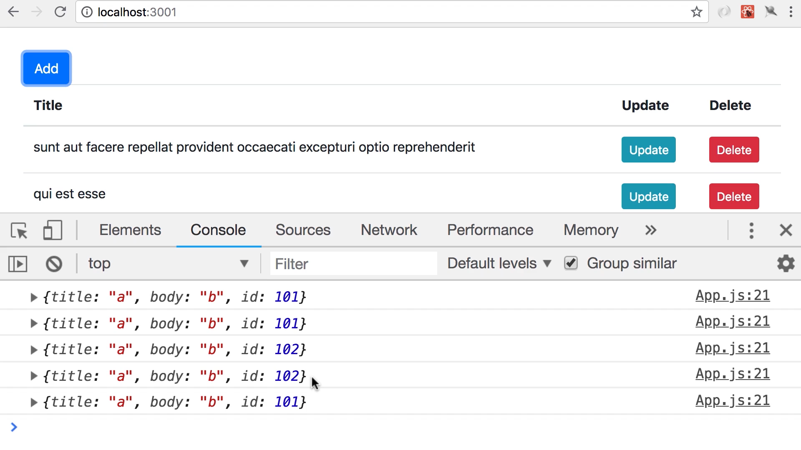
Click on add multiple times we see the id is repeatedly generated because this is a fake server

Slide 7
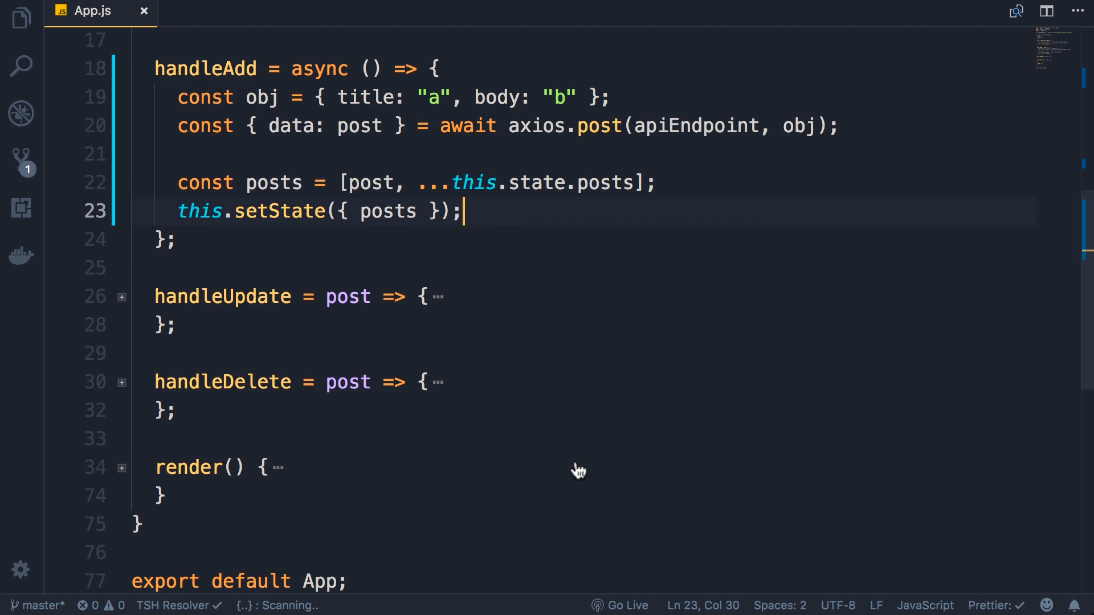

Slide 8
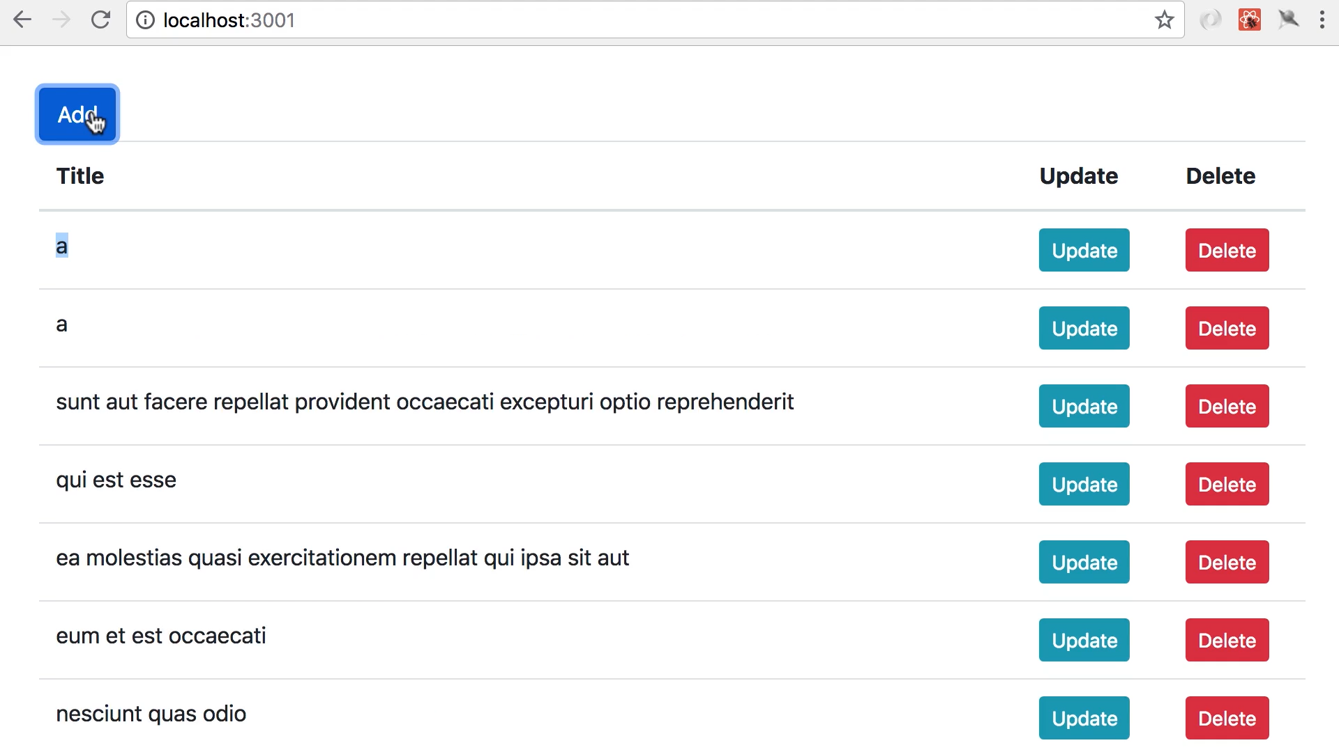

Slide 9
